Slide 1

Microsoft Financial Statement Analysis
By Muhammad Haziq

Slide 2
Executive Summary

Slide 3
Executive Summary
The purpose is to analyze Microsoft’s financial performance from 2022 to 2024, focusing on key trends, strengths, and potential risks for stakeholder
Microsoft is a global tech leader that has shown strong financial in recent year
The analysis delves into the company's key financial statements, including the balance sheet, income statement, and cash flow statement, to assess its financial stability and future potential.
The objective is to highlight Microsoft's financial performance. It aims to identify key financial strengths and potential risks that could impact investor confidence.

Slide 4
Expenses
Saes, marketing, and general administration dominate expense
Low R&D investment suggests a limited focus on innovation
Profitability
Net income and revenue increase sharply from 2023 to 2024
EPS rose from 10 to 12, signaling better profitability per share
Gross Margin – Consistent growth from 2022 to 2024, reflecting improved efficiency
Liquidity
Increase in current and quick ratio, showing better short-term financial health.
Debt to equity ratio decreased, showing reduced reliance on debt.
Investment and cash flow
Rising investment spending, with negative cash flow from investment
Strong operational cash flow but slow payment collection raise potential cash flow risk
Profitability ratio
ROA and ROE decline from 2023 to 2024, signalling reduced profitability
Financing Activities
Increasing reliance on financing which could impact financial risk

Slide 5
Overall strengths and challenges
Microsoft have strong growth in terms of profitability, revenue growth and liquidity improvement
Microsoft challenges include declining ROA (return on asset)/ ROE (return on equity) and slow payment collection may pose the risk
Microsoft is well positioned for growth but must address profitability concern for sustainable long term growth

Slide 6
Introduction

Slide 7
Understanding financial performance is crucial for stake holder to navigate challenges and ensure growth and profitability of the company
The analysis focus on Microsoft Corporate its financial performance from 2022 to 2024 from 10k report.
Microsoft has experience revenue growth and increase net income, yet face challenges in profitability and cash flow management
The purpose is to explore key financial metric and their implication for Microsoft operational efficiency in financial health
The analysis will focus on:
Income statement – trends in net income, gross profit margins, expenses, EPS and revenue
Balance sheet – liquidity ratio, debt level, asset and liability and overall financial position
Cash flow statement – Dynamics of cash flow from operating, investing and financing activity

Slide 8
Methodology

Slide 9
Data Collecting | → Scrape the data from Microsoft Cooperation's SEC EDGAR 10-K report
Data Cleaning | → checking missing values and duplicate rows
Data transformation | → Use Python to transform and transpose the data into a more readable format
CSV Creation | → Create three CSV files for the balance sheet, income statement, and cash flow statement
Excel Import | → Import CSV file into Excel, using different sheets for each statement
Power Bi Visualization | → Import the Excel file into Power BI to visualize the data
Dax Calculation | → Use the DAX formula to calculate key metrics, including ratio, turnover, ROA, ROE, cash flow investing, financing, and operating.
Report creation | → Generate a comprehensive report summarizing finding and insights based on the visualized data

Slide 10
Income statement

Slide 11


Slide 12
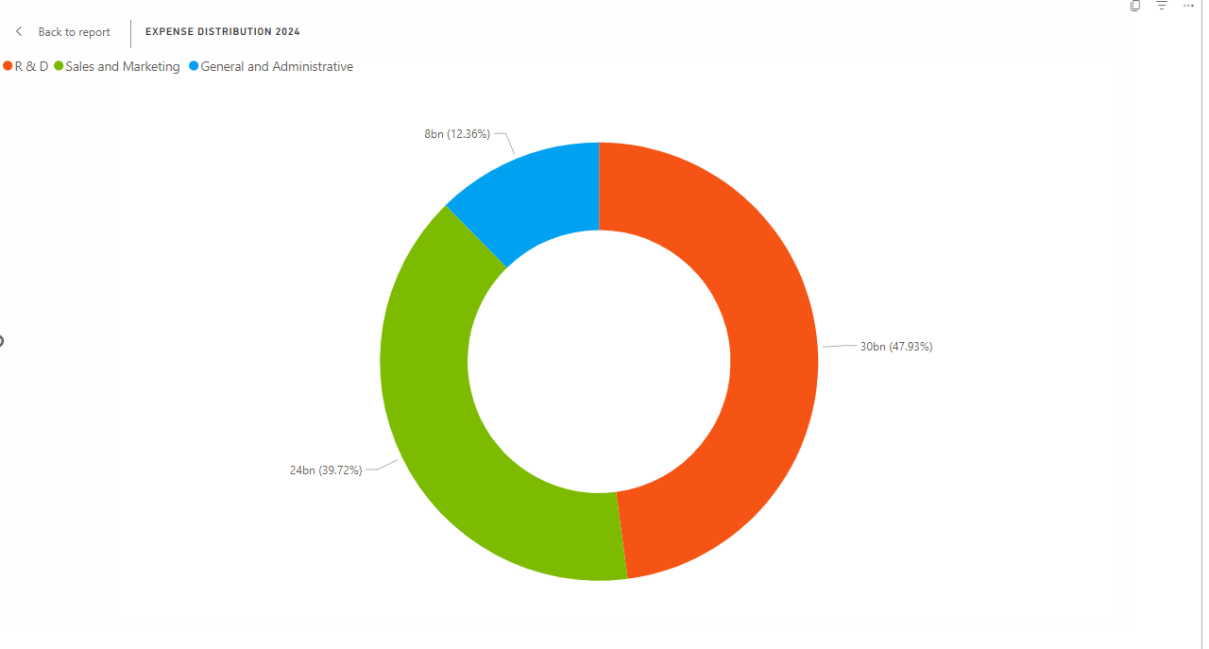
Expense distribution
Sales and marketing & General administration dominate the expenses
______________________________
Research and development which might suggest relatively lower investment in innovation compared to other areas

Slide 13
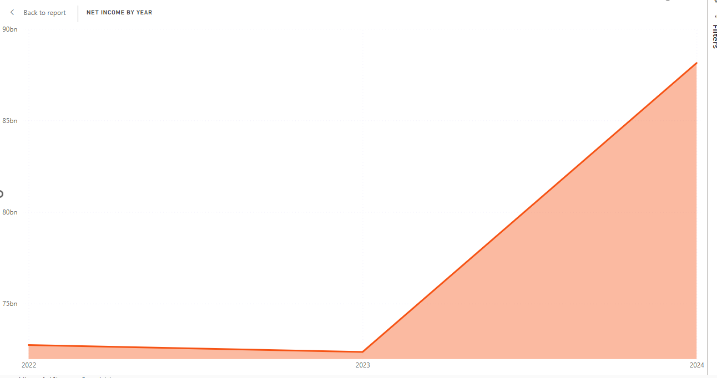
Net income
Net income has been increasing yearly, with a sharp rise from 2023 to 2024, reflecting Microsoft’s growing profitability
_____________________________
The sharp rise suggests that Microsoft is becoming more profitable which could lead to investor confidence and potential higher stock price

Slide 14
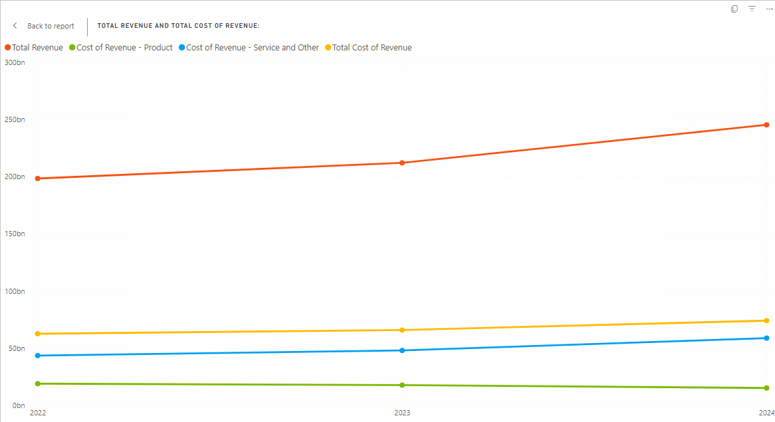
Revenue vs cost of revenue
Total revenue and cost revenue is increasing
________________________________
Revenue growth outpaces the cost, suggesting improved gross profit margin
________________________________
Microsoft is becoming more efficient in generating profit, which leads to higher profitability

Slide 15
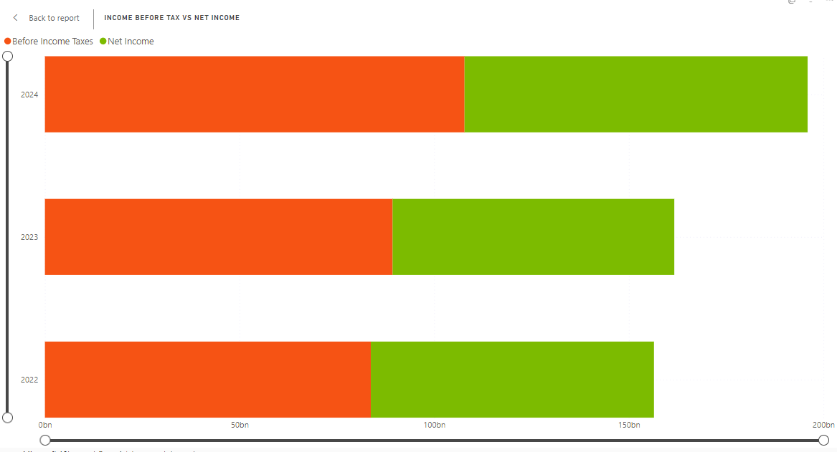
Income Before Tax and Net Income
There is a healthy gap between income before tax and net income across the years
______________________________
This suggest efficient tax management

Slide 16
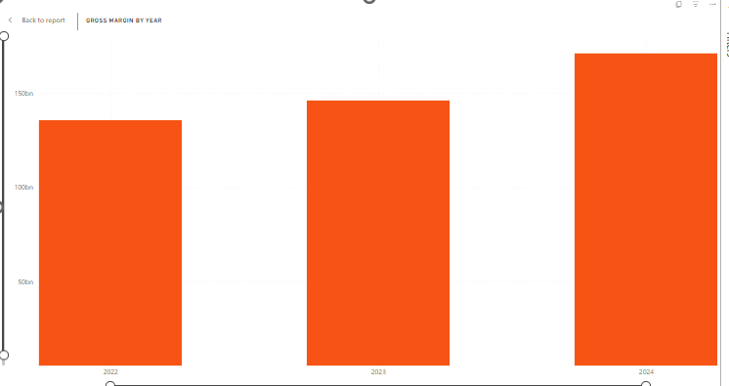
EPS
There is an increase in EPS from 2023 to 2024, growing from 10 to 12
___________________________________
It indicates improved profitability per share
___________________________________
Microsoft stock is earning more money which is a positive sign for investor
___________________________________
It suggest that the company is becoming more profitable and could lead to higher stock price or dividend

Slide 17
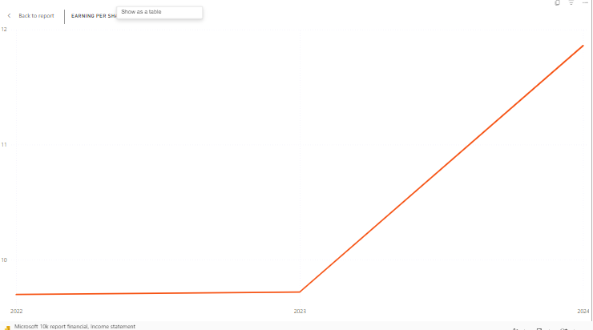
Gross margin
The gross margin shows consistent growth from 2022 to 2024
________________________________
Implying better operation efficiency and profitability
________________________________
Microsoft is generating more revenue than the cost associated with producing the revenue, they are more efficient and profitable over time

Slide 18
Balance sheets

Slide 19

Microsoft Power BI

Slide 20
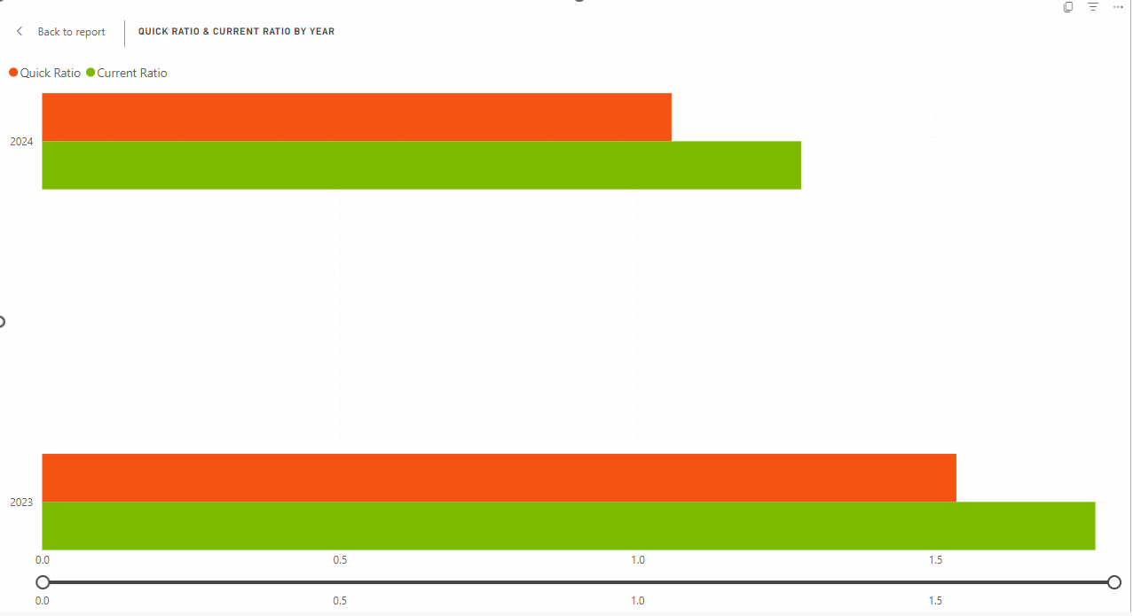
Quick ratio and current ratio
The slight increase in the current ratio in 2024 compared to 2023 indicates that Microsoft's ability to cover its short-term liabilities and assets has improved slightly.
___________________________________
Similar increase in quick ratio – suggests that Microsoft’s liquidity position considering only high liquid assets is getting stronger
___________________________________
Microsoft is becoming more liquid which may indicate more effectiveness in managing short-term ass and liability

Slide 21
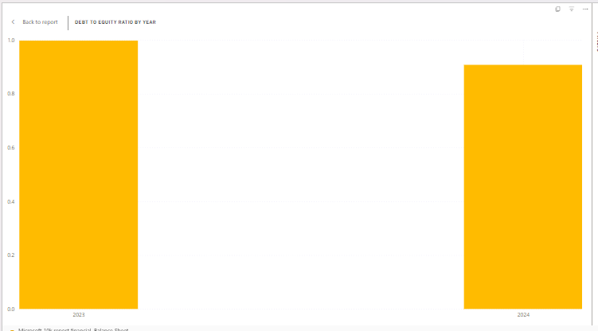
Debt to equity ratio
The debt to equity is decrease from 1 to 0.91
___________________________________
Microsoft is using less debt compared to its equity
___________________________________
The lower ratio suggests that Microsoft is in a safer financial position
___________________________________
Investors find this reassuring because it shows the company is less reliant on borrowed money, which reduces financial risk

Slide 22
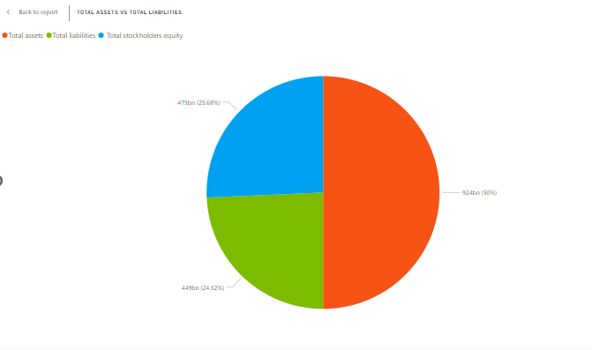
Total asset vs total liabilities
Microsoft’s total assets significantly outweigh its total liabilities, with stakeholder equity forming a substantial portion of the total
________________________________
The company is financially sound, with assets far surpassing liability
________________________________
Indicating stability and the ability to meet obligation

Slide 23
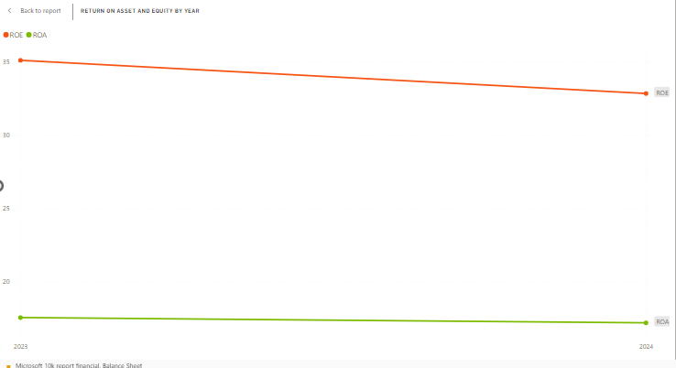
Return on Asset and Liability
Both ROA and ROE show a decline from 2023 to 2024 signalling a decrease in profitability
___________________________________
Microsoft is generating less profit from its assets and equity
___________________________________
Despite an improvement in liquidity, the company is facing challenges in maintaining efficient profitability
___________________________________
This could point to concern for investor

Slide 24
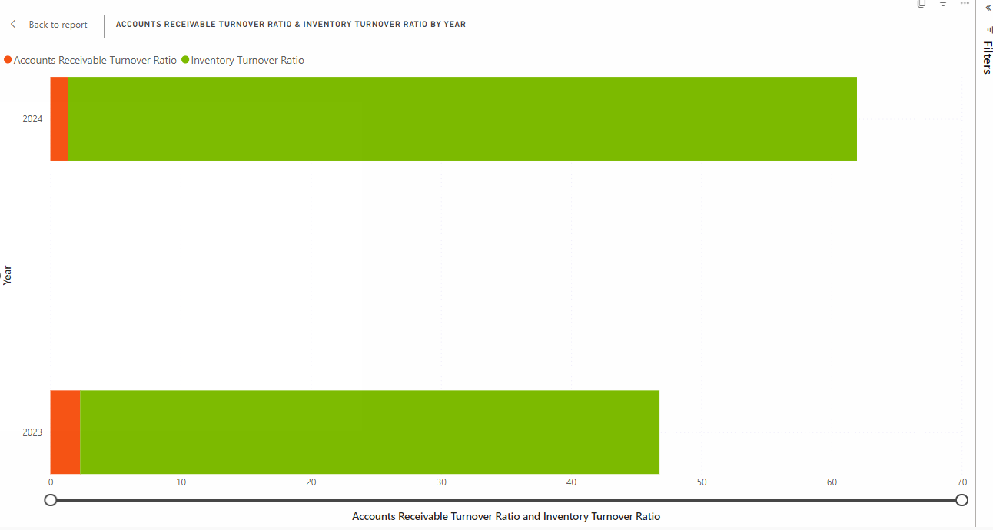
Account receivable and inventory turn over ratio
Inventory turnover ratio increase in 2024, indicates that Microsoft is selling its inventory faster than before
______________________________________________
The account receivable drop from 2.29 (2023) to 1.33 (2024)
______________________________________________
Microsoft is selling products quickly, but slow payment collection could lead to cash flow issue
_______________________________________________
While sales are strong, the collection of payment needs improvement.
_______________________________________________
Microsoft doesn’t collect money faster, they could run into cash shortage despite high sales

Slide 25
Cashflow statement

Slide 27
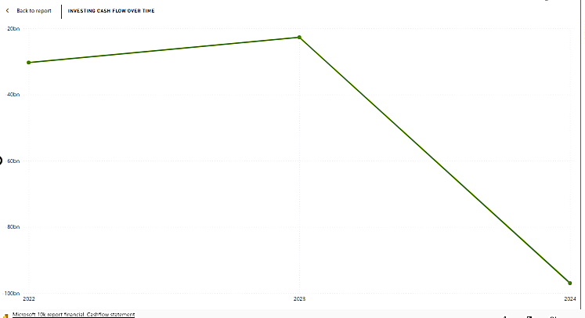
Investing cash flow
The investing cashflow shows a declining trend from -40 bn (2022) to -100bn (2024)
_________________________________________
This indicates that Microsoft has increased its investment expenditure over the year
_________________________________________
Increasing investing cash flow could imply a strategic focus on growth and expansion
_________________________________________
Investor may interpret this as a commitment to future revenue generation

Slide 28
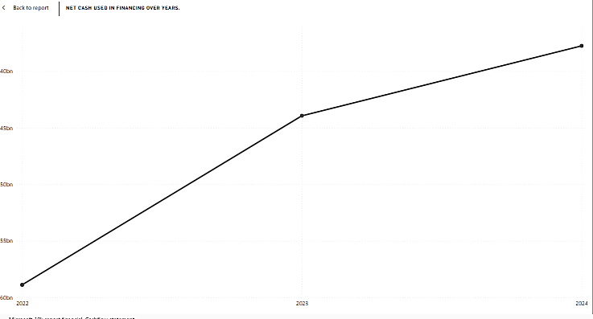
Net cash used in financing
The net cash used in financing has been consistently increasing.
__________________________________________
Moving -60bn (2022) to around -40bn (2024)
__________________________________________
This suggests that Microsoft is relying more on financing activities to support its operation or investment
__________________________________________
The upward trend in net cash suggests Microsoft might take on more debt or increase shareholder payout
__________________________________________
This could affect the company’s risk profile and impact confidence

Slide 29
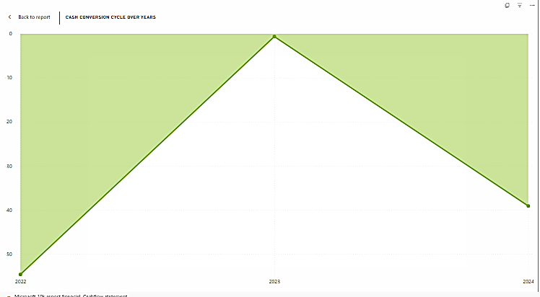
Cash conversion cycle
The cash conversion cycle fluctuates but shows a general decrease from 2022 to 2024.
______________________________________
A lower cash conversion cycle is positive, indicating that the company is becoming more efficient in managing its cash flow
______________________________________
Improvement in the cash conversion cycle highlights operational efficiency
______________________________________
Positive signal for stakeholders regarding management practice

Slide 30
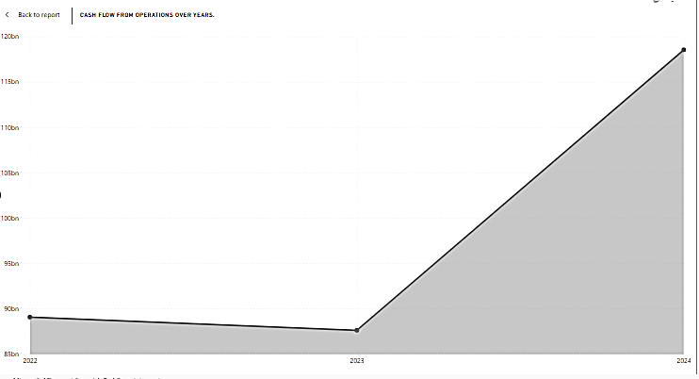
Cash flow from operation
There is an increase in cash flow from operation from 90bn (2022) to over 120bn (2024)
______________________________________
This suggests strong operation performance and growth in revenue generation
______________________________________
The rising cash flow from the operation has substantial growth potential.
______________________________________
This enhances Microsoft’s ability to weather economic uncertainties or invest in a new opportunity

Slide 31
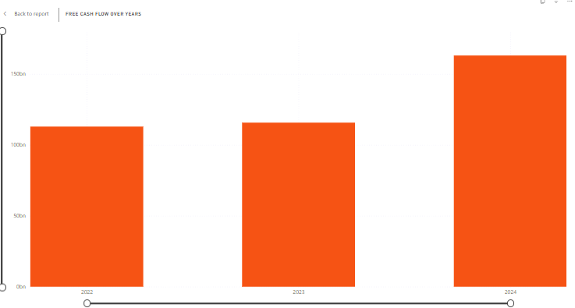
Free cash flow
Free cash flow increases over the year
________________________________
Indicate that Microsoft has more cash available after accounting for CAPEX
________________________________
This is a good sign for investors, as it suggests the company has ample resources for reinvestment, dividend, or debt reduction

Slide 32
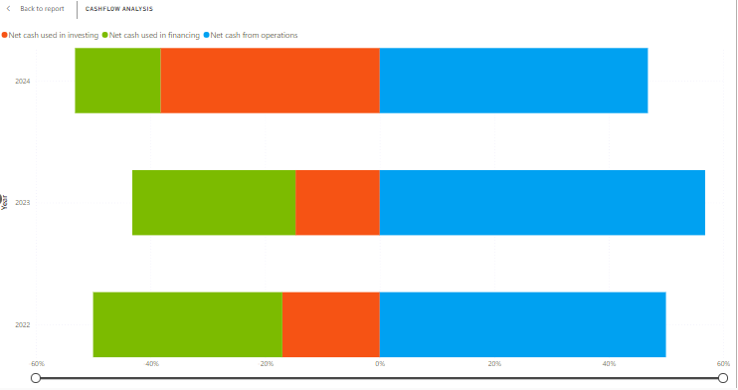
Cash flow analysis
Cash flow analysis indicates net cash trend in investing, financing, and operational activity over the year
__________________________________________
The bar chart shows a healthy diversification in cash flow sources and use
__________________________________________
The overall positive cash flow metric could boost investor confidence
__________________________________________
It will potentially impact stock performance positively as investors view Microsoft as a Financially health and strategically positioned company

Slide 33
Discussion

Slide 34
Summary and Interpretation
Strong financial performance: rising revenue, profitability, liquidity and safe debt level
Increase net income and revenue indicate efficiency and profitability growth
Higher EPS and gross margin show better profitability per share
Declining ROA and ROE highlight challenges in profitability despite improve liquidity

Slide 35
Limitation and recommendation
Limitation
Low Research and development spending limits insight into future innovation
Declining in ROA (return on assets) and ROE (return on equity) raises concerns about long-term profitability
Slow receivable collection risk cash flow issues
Recommendation
Further studies on research and development investment and innovation potential
Focus on addressing declining ROA, ROE and improving receivable management
Analyse cashflow trends about external economic factors for strategic insight.

Slide 36
Conclusion

Slide 37
Conclusion key points
Microsoft’s financial performance from 2022 to 2024 reflects growth in profitability, efficiency, and liquidity, with some areas of concern
Net income and revenue growth outpace cost
Increase liquidity with higher current and quick ratios indicate strong short-term financial health
Decline in ROA and ROE suggests reduced profitability from asset and equity
Slow payment collection despite strong sales could lead to potential cash flow issue
Increase investment spending highlight a focus on growth and expansion
Growing reliance on financing could raise concerns about financial risk

Slide 38
Highlights and final thought
Rising profitability and efficient cash flow management may boost investor confidence and stock price
Strategic investment indicates future growth potential, but a declining profitability ratio may signal challenges in maintain long-term efficiency
Effective liquidity management strengthens Microsoft’s ability to meet short-term obligations
Microsoft is well positioned for continued growth, but the company should address challenges in profitability and cash flow management to sustain investor confidence and ensure long-term stability

Slide 39
Reference

Slide 40
Reference
Data
U.S. Securities and Exchange Commission. (2024). Microsoft Corporation (Form 10-K). https://www.sec.gov/ix?doc=/Archives/edgar/data/789019/000095017024087843/msft-20240630.htm
Data and report
HAZCHEM234. (2024). Microsoft financial statement [Data set]. GitHub. https://github.com/HAZCHEM234/Microsoft_financial_statement

